Slide 1
[insert shared logbook early stages]

Slide 2
Logbook Entry 3 — 08/12 — 12:42
Title: Defining Group Roles and Subsystem Requirements
Overview:
After we established the main system requirements and the overall direction for the project, including initial flowcharts and architectural models, we moved on to clearly designating our group roles and breaking down the system into subsystems.
1. Assigning Roles and Responsibilities
We defined who would handle which parts of the system. My responsibility is the Python camera subsystem. This means I’ll be focusing on setting up the image processing, detection logic, and the communication of results back to the Raspberry Pi.
2. Outlining Subsystem Requirements
My first task within the Python camera subsystem is to come up with a detailed list of its specific requirements and specifications. This will help guide the implementation and ensure that the camera’s detection logic meets the overall system goals.
[insert table]

Slide 3
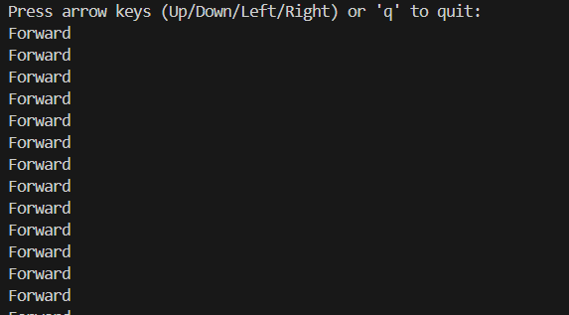
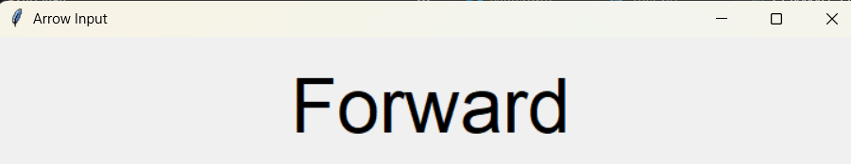
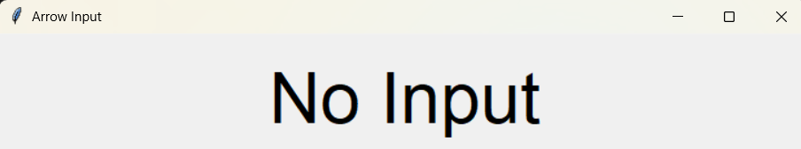
Logbook Entry 4 — 08/12 — 16:33
Title: Initial Repo Setup and Input Testing Script
Overview:
With the group roles set, I turned my attention to the practical side of my subsystem. Since we hadn’t yet fully defined the exact signals I’d need to send to the Pi for controlling the ball’s movement, I decided to start by getting my development environment ready.
1. Setting Up the GitHub Repository and VS Code Workspace
I created a new GitHub repository for the Python code and set up a dedicated folder on my machine to work from in Visual Studio Code. This ensured I had version control in place from the start and a clean environment to build and test my scripts.
2. Writing the First Test Script (test.py)
To begin understanding how to handle inputs and eventually translate them into signals, I created a test script called test.py. The goal of this script was simple: when I pressed certain keys (like arrow keys), the script would display the name of the key being pressed. If no key was pressed, it would display “no input.” This was to ensure I could detect and handle the correct input states before converting these inputs into signals for the Pi.
3. Purpose of the Input Test
This step allowed me to verify that the Python script could reliably read and interpret keyboard inputs. Once confirmed, I could then use this input handling logic as the basis for generating the commands that would be sent to the Pi to achieve the desired manual inputs outlined in Subsystem Requirement 8 “8. System must be able to communicate manual motion inputs to robot”
Version 1 output: Version 2 output:

Slide 4
Logbook Entry 5 — 09/12 — 15:50
Title: Prototyping the Rolling Robot with LEGO
Overview:
Today I took a break from coding to focus on the physical prototyping of the rolling robot mechanism inside the ball. Using LEGO, I constructed a prototype designed to test how we might achieve stability and movement.
1. Building the Initial LEGO Prototype
I built a model with a large weight at the bottom to keep the centre of gravity low, which should help stabilise the ball. I also added stabilising wheels higher up in the structure to test how well the robot could maintain balance and roll smoothly.
2. Comparing Configurations
In parallel, Jake created a second LEGO model with a different internal configuration. This allowed us to experiment with different layouts and identify which design might give us better stability and control.
3. Next Steps
With the prototypes in hand, our next step will be to test these configurations to see how well each model performs and decide on the final design for the rolling robot mechanism. Once we have a stable prototype, I’ll return to the code to integrate the movement signals accordingly.

Slide 5
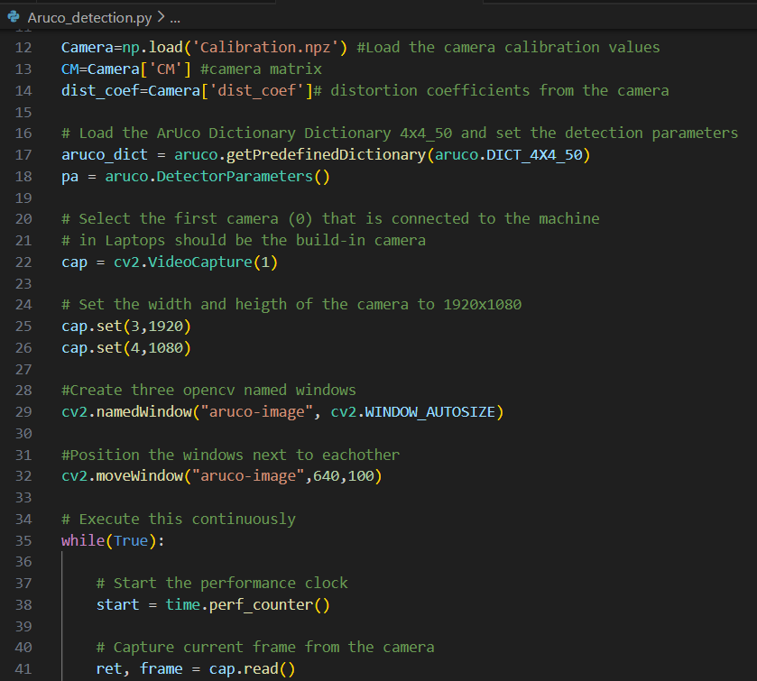
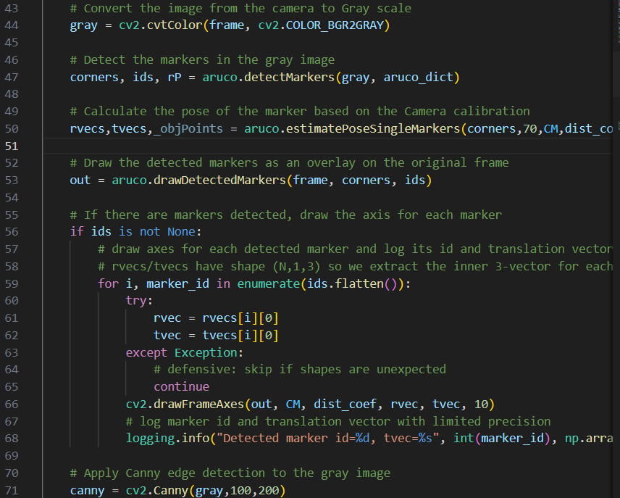
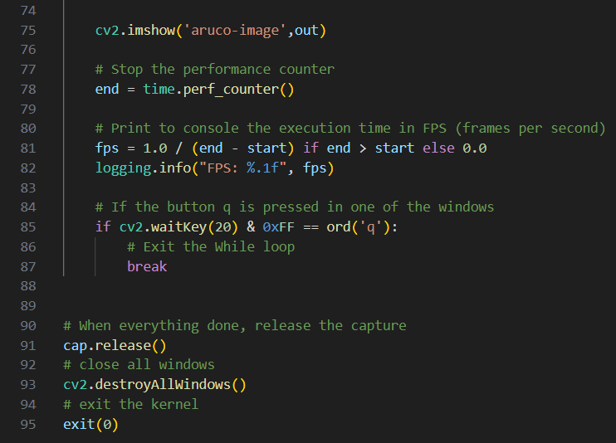
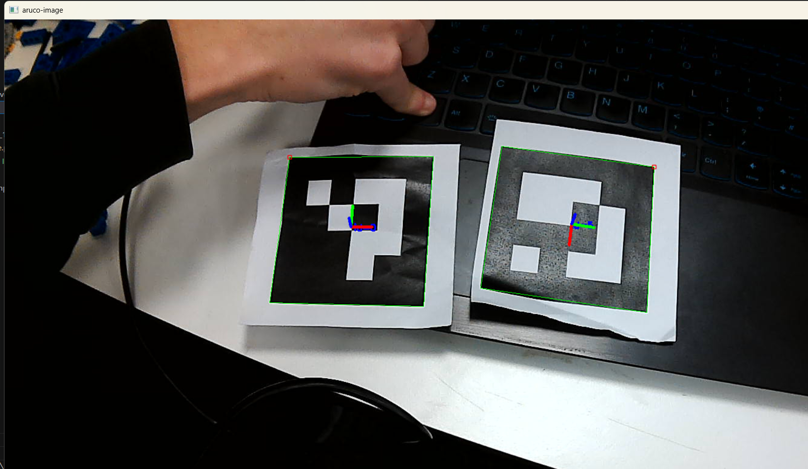
Logbook Entry 6 — 09/12 — 21:35
Title: Integrating ArUco Code Detection and Determining Relative Positions
Overview:
In order to meet Functional Requirement 1—ensuring the camera can determine the ball’s target and home positions—I started integrating the ArUco code detection scripts provided in the tutorial. I copied cv_python_template.py and cv_python_aruco_4_10.py into my working folder and created a duplicate script named Aruco_Detection.PY.
Setting Up ArUco Code Detection
I began by removing unnecessary windows from the script to just display the aruco detection window, and calibrated the camera:

Slide 6
Logbook Entry 6 cont.
Establishing Logic for Relative Positioning
I outlined the logical requirements needed to determine the relative positions of these two codes. The aim is to determine the relative x and y positions between the Aruco code of the robot, and its first target, whilst keeping them on the same z-plane so that we can ignore any vertical differences. This will allow us to convert their positions into relative angles, direction vectors, and total distances.
1.
3. Next Steps: Physical Testing and Calibration
Next, I will need to test with physical ArUco codes to measure their dimensions and input this data for calibration. By constraining everything to the same plane, I can ensure that our calculations focus only on the relevant horizontal distances and directions.

Slide 7
To do list 05/01
Calibrate camera
Test that camera can find 2 aruco codes
Display vectors for these
Work out relative positions
Figure out how to constrain them to single plane
Work out relative distance and angle on said plane
Convert relative position and angle to set of commands

